Slide 1

ADVENTURE WORKS PROJECT
Business Intelligence Report

Slide 2
Agenda
Objectives
Approach
Requirement Analysis Questionnaire
MSTR Setup
Object Details
Schema & Objects
Datasets & Dashboards
Testing
Issues faced & Lessons learnt

Slide 3
Objective
01

Slide 4
Objective
The Company Adventure Works is a Bicycle manufacturer – Adventure Works Cycles.
Adventure Works is a brand dedicated to quality and durability, with a focus on connecting people and the outdoors. We partner with retailers around the world to help get our innovative apparel and gear into the hands of millions of customers.
The Key Objective is to analyse Sales data for 3 years – 2014, 2015 and 2016 to help compare how the sales performance are as compared to last year sales. It is divided into two major categories i.e., by Product and Customer. The main KPIs required are Sales, Profit and No. of Orders.

Slide 5
Approach
02

Slide 6
Approach
Objectives
Questionnaire
MSTR Setup
Report Details Doc
Issues & fixes
Testing
Datasets & Dashboards
Schema & Objects

Slide 7
Requirement Analysis and Questionnaire
03

Slide 8
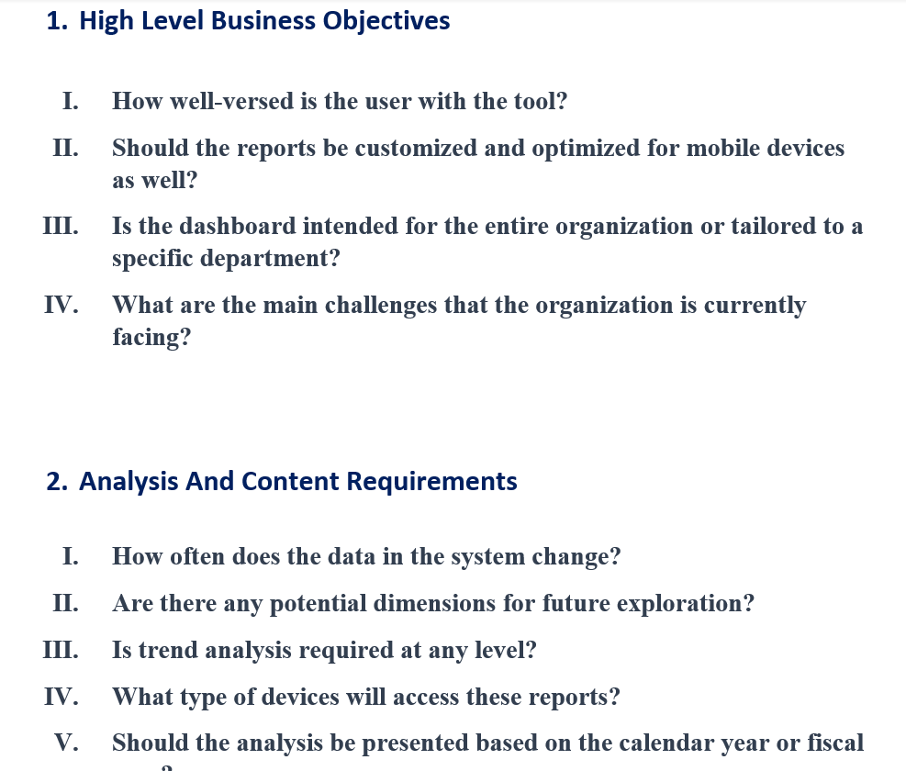
Requirement Analysis and Questionnaire

Slide 9
Data Validation
04

Slide 10
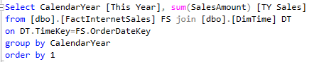
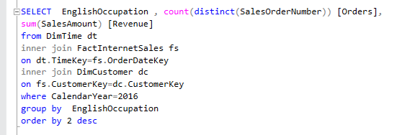
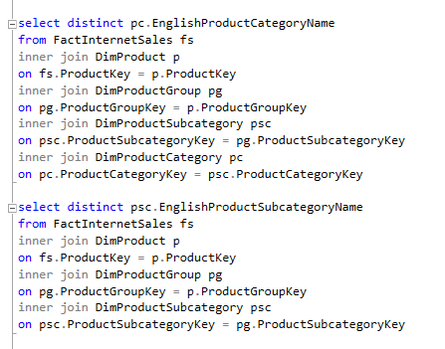
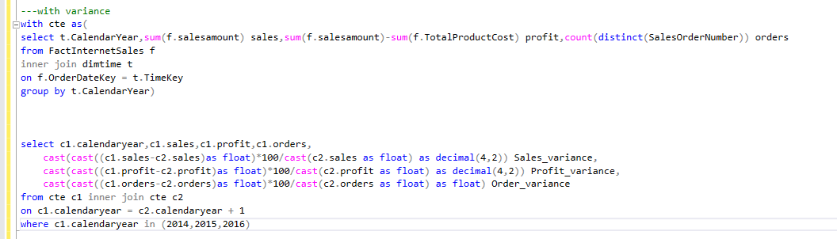
Data Validation
The Data provided is analyzed to verify the scope of requirements made by the client.

Slide 11
MSTR Project setup & Data Modelling
05

Slide 12
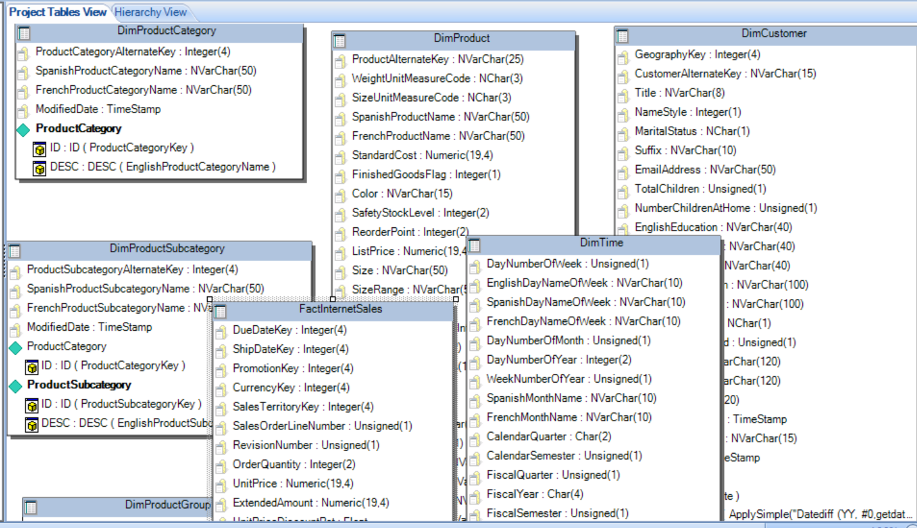
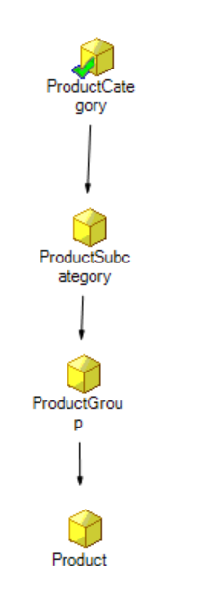
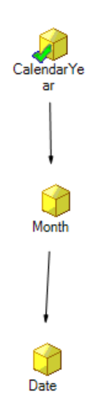
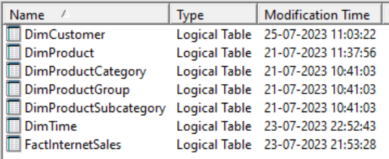
Data Model

Slide 13
Object Creation
06

Slide 14
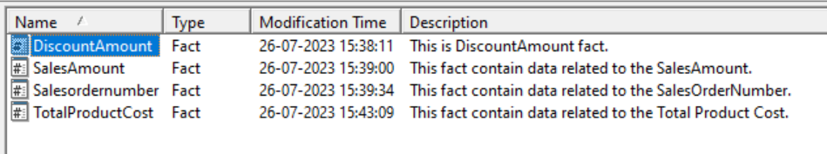
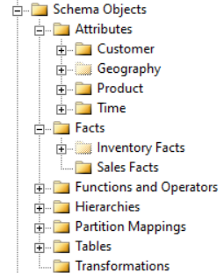
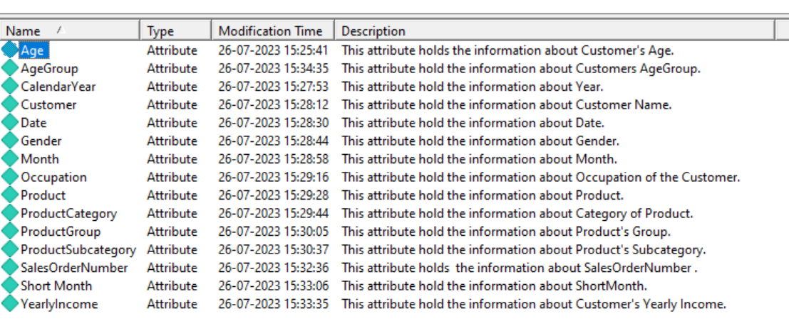
Schema Objects
Transformation, Attributes & Facts

Slide 15
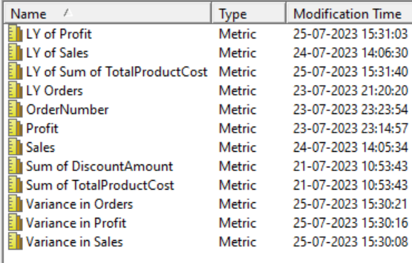
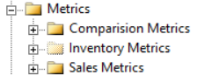
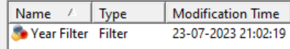
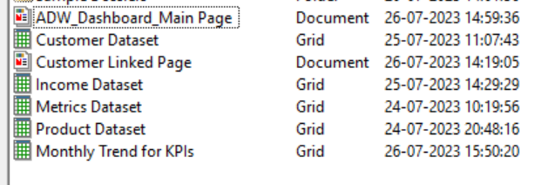
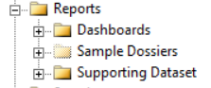
Application Objects
Metrics & Dataset

Slide 16
Dashboard Creations
07

Slide 17
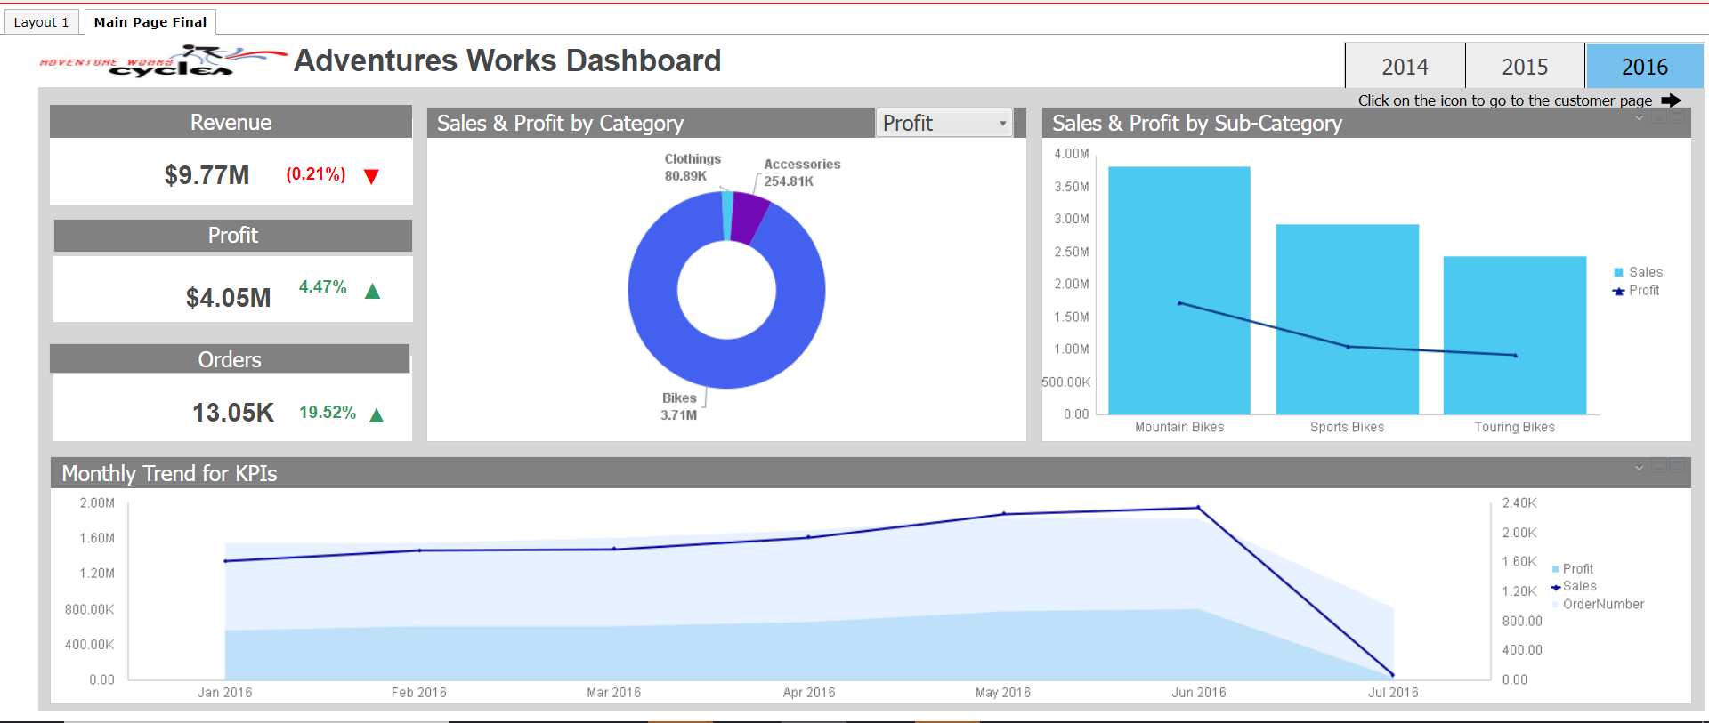
Product Dashboard

Slide 18
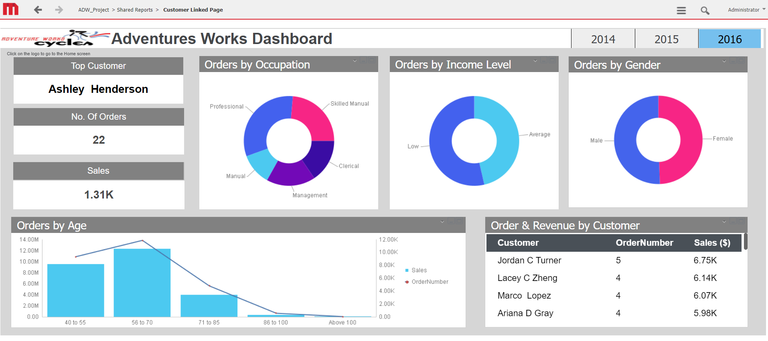
Customer Dashboard

Slide 19
Data testing
08

Slide 20
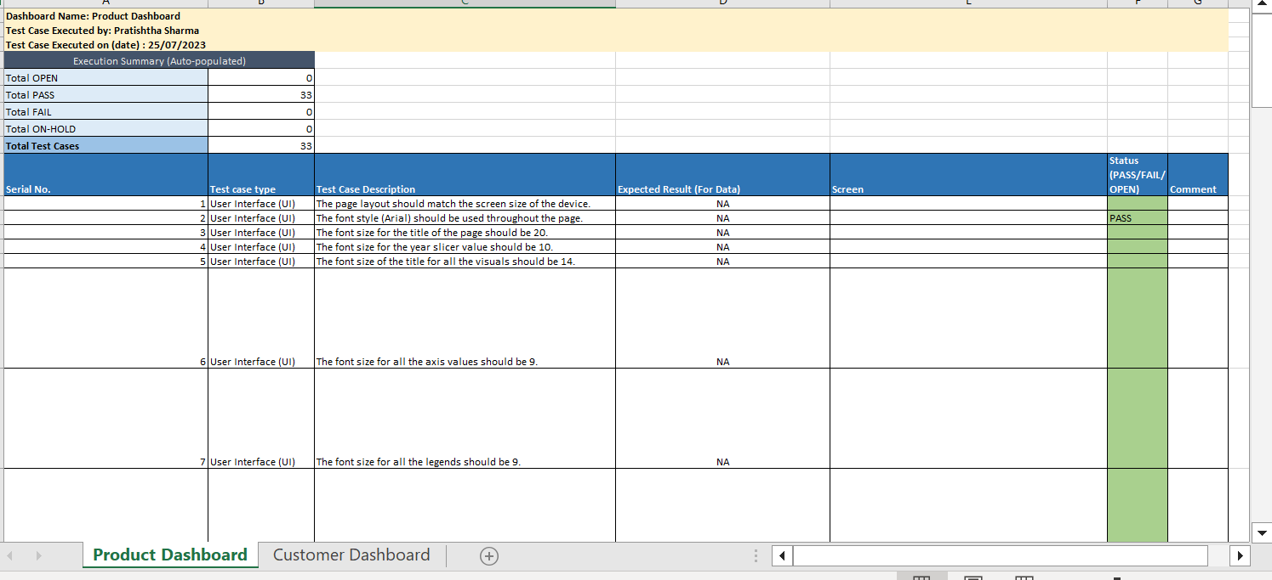
Data testing
Testing Based on Functionality, Interface and Data is executed and documented as shown below

Slide 21
Issues Faced & Lessons Learnt
09

Slide 22
Issues Faced & Lessons Learnt
Invalid syntax in pass through functions
Cartesian Join Governing ( Report execution failed )
Fact cross join attribute error & Fact not available at required level
Metric “Order” had its dynamic aggregation set as Default.
MSI Session logout
Suddenly Dashboard 1 got blank in the presentation mode after completing the whole dashboard.
Apply Simple or case statements
Fact & Attribute joining at grain level
Corrected the Invalid Hierarchy of attribute & Correction child – parent relationship
Set the dynamic aggregation of the metric to Total.
Re-configuration of I-Server
Always make versions. I had to redo the whole dashboard.

Slide 23
Email address:
pratishtha.sharma@infocepts.com
Contact number:
+919602449392

